Slide 1
WATCH STORE - Ecommerce Website
Submitted by: Karan Saini (2210990481) Kapil Malhotra (2210990475) Kartik Verma(2210990490) Jasmeet Singh (2210990449)
Submitted to: Dr.Baljit Kaur Dr.Vikas Patel

Slide 2
Outline
Overview
Key Features
Live Demo
Product Catalog
Check Out Page
Tech Stack

Slide 3
Overview
Watch Store stands at the forefront of e-commerce innovation, offering a seamless shopping experience enriched with cutting-edge React Library.
With a mission to redefine the way users discover and engage with products online, Watch Store integrates sophisticated React Properties to deliver personalized recommendations and ensuring that every user finds exactly what they need with ease.

Slide 4
Key Features
Product Catalog: Keep track of various watches available in the store. Each watch could have properties like name, brand, description, price, image, and stock availability.
Shopping Cart: Allow users to add watches to their shopping carts, view their cart contents, and proceed to checkout.
Product Details: Display detailed information about each watch when clicked, including additional images, specifications.
Responsive Design: Ensure that the website is optimized for various devices and screen sizes, providing a seamless experience across desktops, tablets, and smartphones.

Slide 5
Search Functions : Functions to enable users to search for products within the website, including implementing search filters and displaying search results.
Newsletter Signup : Allow users to subscribe to newsletter to receive updates on new arrivals, promotions and exclusive deals
Cross - Selling and Up Selling : Implement features to suggest related or complementary products to customers during the shopping journey , increasing average order value.

Slide 6
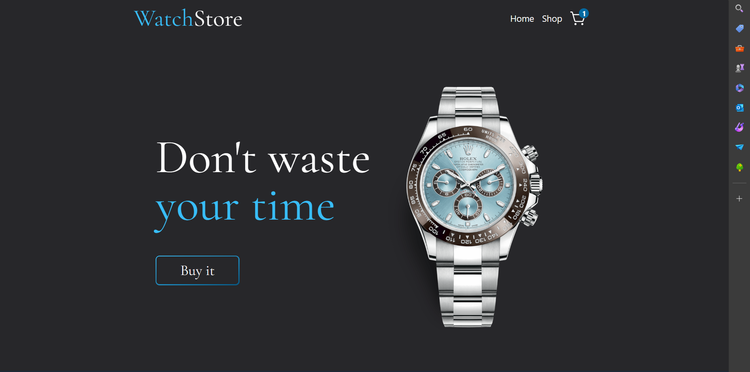
HOME PAGE

Slide 7
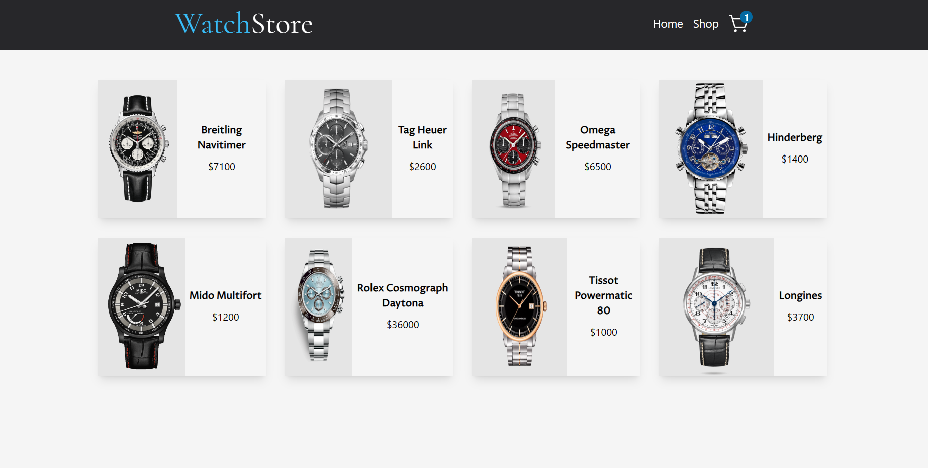
PRODUCT CATALOG

Slide 8
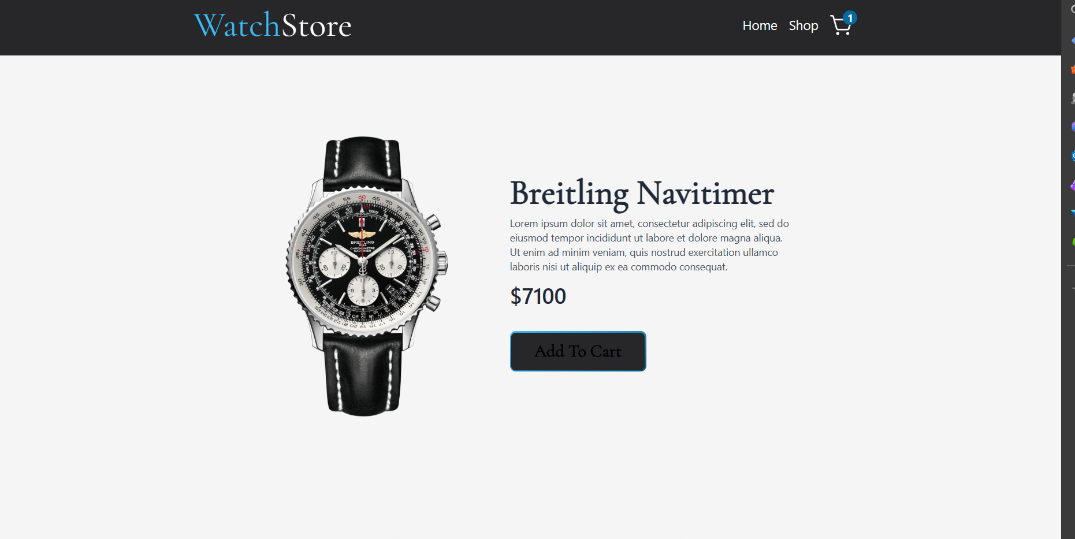

Slide 9
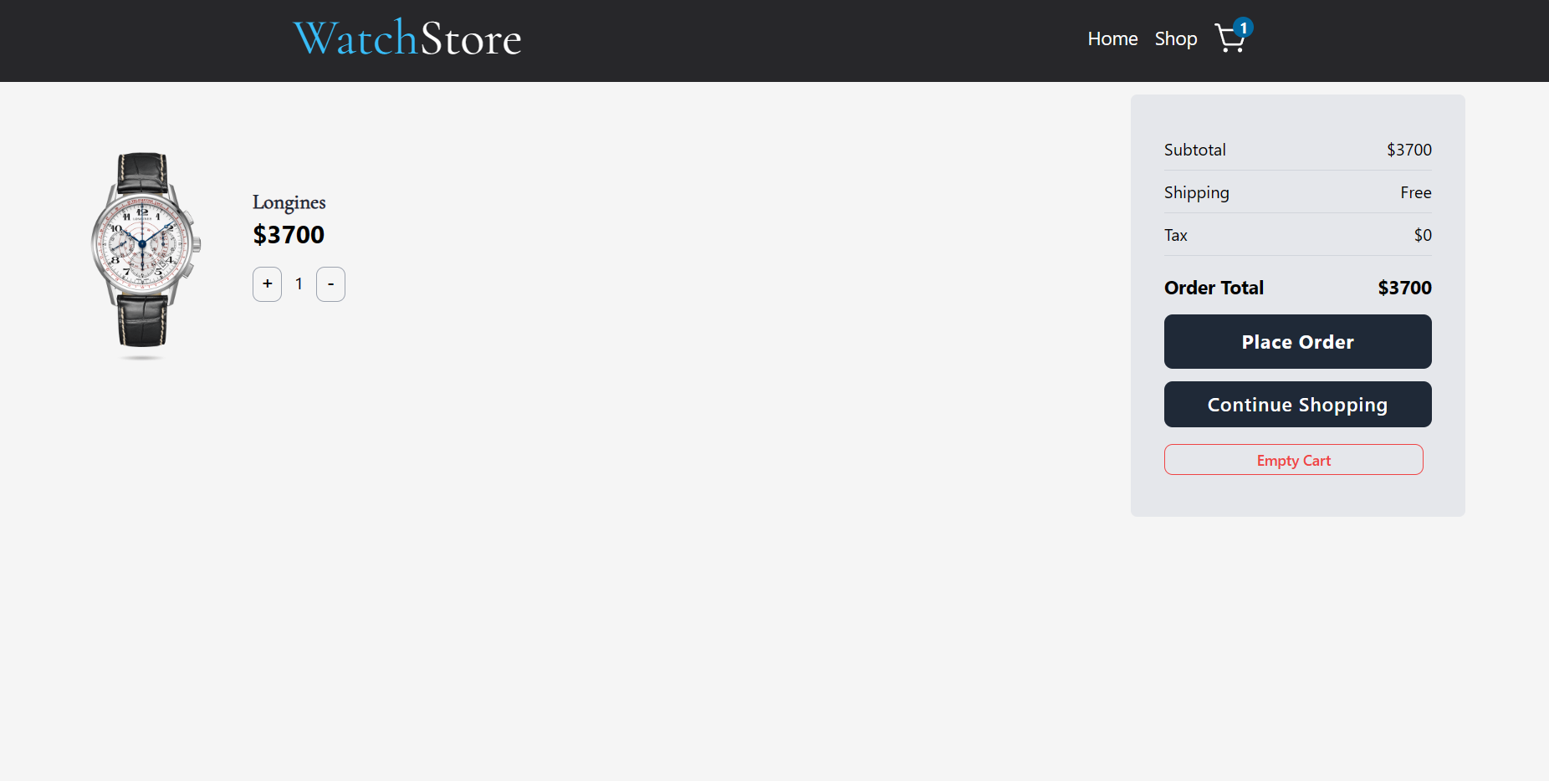
CHECK OUT PAGE

Slide 10
Tech Stack
HTML
CSS
JAVA SCRIPT
REACT

Slide 11


